Slide 1
ISD2 to SmartOpenWrt
Steven lin

Slide 2
mm init
上patch
新增連結 default config
mm pmenu
管理patch
mm kmenu
調整 kernel config
mm menuconfig
調整 product_config.make

Slide 3
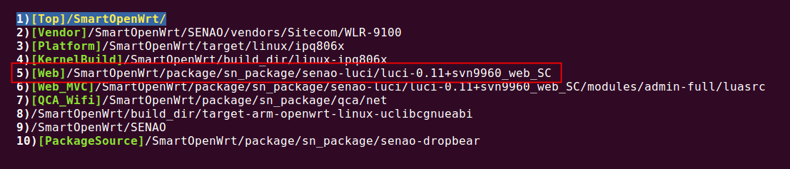
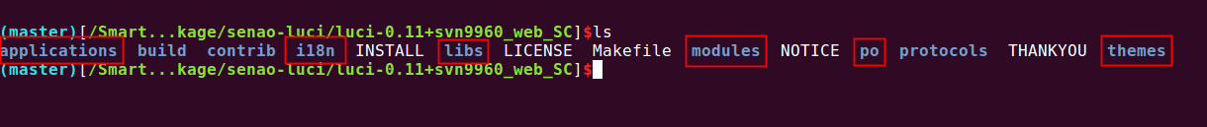
find the web_html
cd2

Slide 4
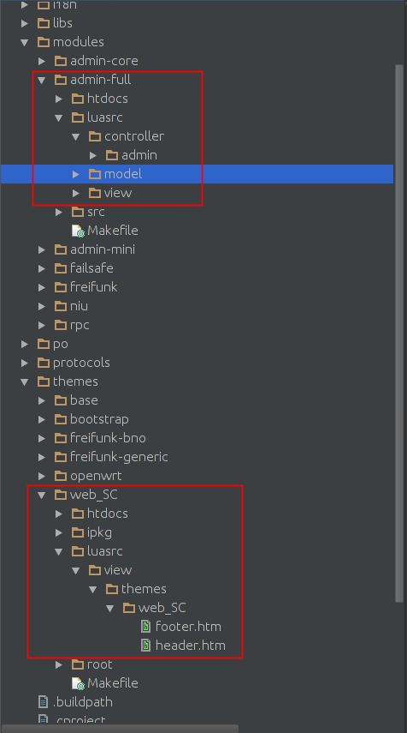
Web IDE
admin-full
themes
網頁執行command by Lua
luci.sys.exec( command )
Luci modules Doc
https://goo.gl/lbOJtS
Nixio modules Doc
https://goo.gl/L2y5g9

Slide 5
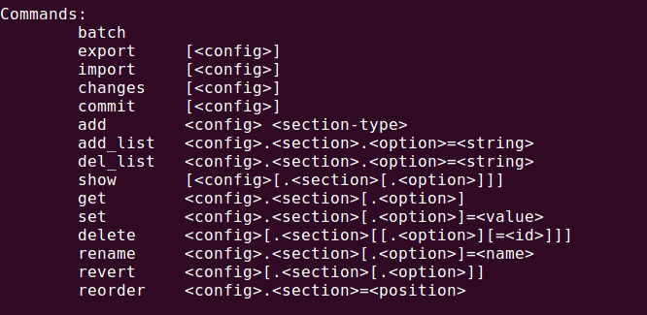
Web application
controller = cgi
view = html
module = cgi + html
UCI
uci = apCfgSetValue(xxx)
uci support both command and web

Slide 6
/SmartOpenWrt/SENAO/package
libapi = apcfg_api
sena_sysutil = sysutil
/etc/init.d/shell = sysconfig
ucitrack = applychanges.c

Slide 7
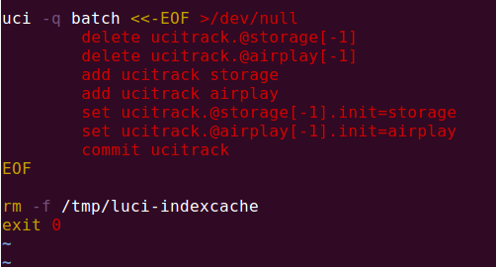
ucitrack
新增 ucitrack
storage.defaults
/etc/uci-defaults/storage
Ucitrack 如何跟 init.d/shell 連動?
uci要對config 下 apply
uci:apply(config)
ucitrack 要有紀錄
讀取相對的config後,執行 restart command

Slide 8
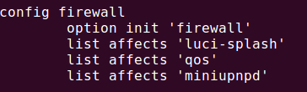
一個config連動多個shell
affects

Slide 9
SmartOpenwrt config = ISD2 storage
/etc/config/ = /storage
Config
configs = cfgtable.h
option = tokens

Slide 10
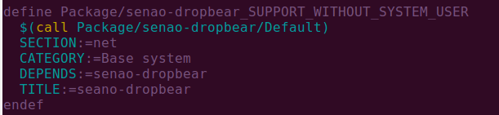

Package Add a define
SmartOpenWrt not support gconfig.h
intergrated into Makefile

Slide 11
Default Value
在ISD2 用 gconfig.h 與 product_config.make去定義一些 default Value
SmartOpenWrt如何處理
host
vendor 的 default 值(非 package)
sn_files in vendor
自我定義的shell script 跟 default config ( package)

Slide 12
Where is TARGETRAMDISK
EX: /SmartOpenWrt/build_dir/target-arm-openwrt-linux-uclibcgnueabi/root-ipq806x
make target/linux/install
打包整個rootfs,產生新fw
cd ~/vendor; mm image-header
新增seano header,可透過web upload

Slide 13
Reset to default
reset2default = rm -rf /overlay/*; reboot
如何單獨 restart 某個function
/etc/init.d/function [ restart / start /stop ]
/etc/init.d/apcontroller [ disable/enable ]
Remove from /etc/rc.d
相當於把功能移除

Slide 14
sh rebuild-all.sh
-s 不顯示編譯過程
單build package
make package/sn_package/folder/{clean,compile} V=s
cd folder/; mm clean compile

Slide 15
IPK的位置
/SmartOpenWrt/bin/PLATFORM/packages
安裝ipk
cp ipk to /tftpboot
tftp –gr xxxxx.ipk SERVER_IP (切換到DUT)
opkg install xxxxx.ipk

Slide 16
Q & A
請提出開發上遇到的問題
如果知道可以馬上回答或是詢問相關同仁

